Slide 1
TITLE OF PROJECT RICE GRADING
PROF: S.Raj kumar sir
TEAM-8
MEMBERS:
C.CHANDAN KUMAR(16MIS1044)
M.DHANUSH KUMAR(16MIS1046)
V.CHANDRA SHEKAR(16MIS1096)
G.PAVAN KUMAR(16MIS1097)

Slide 2
SOFTWARE REQURIMENTS :
Mat lab (VERSION9.3.0.713579-64 bit.)
OBJECTIVES:
Checking the quality and grading of the rice grains.
PLAT FORMS:
matlab 2017b trail version
WORK DONE IN PREVIOUS REVIEW:
Converting the image into negative and find the impurities in the rice using mat lab. edge detection and image segmentation to find the impurities in the rice like insects.

Slide 3
COMMENTS RESOLVED:
compare the previous edge detection algorithm with any other algorithm
WORK DONE :
Top hat and Object detection for comparision and finding out the impurities

Slide 4
Top hat:
originall = imread('rice11.png');
original=rgb2gray(originall);
imshow(original)
se = strel('line',12,90);
tophatFiltered = imtophat(original,se);
figure
imshow(tophatFiltered)
contrastAdjusted = imadjust(tophatFiltered);
Figure
imshow(contrastAdjusted)

Slide 5
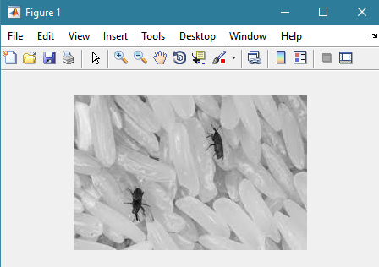
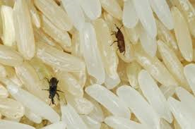
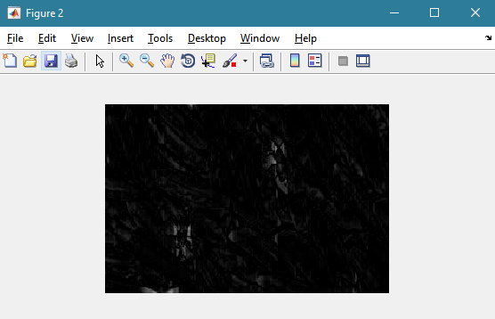
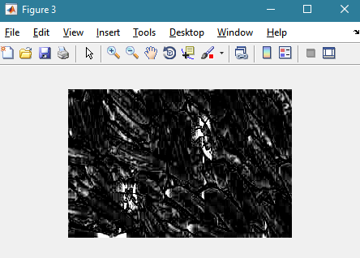
INPUTIMAGE:

Slide 6
Area Or object detection:
boxImage1 = imread('insects.png');
boxImage=rgb2gray(boxImage1);
figure;
imshow(boxImage);
title('original rice with insects image');
sceneImage1 = imread('crop1.png');
sceneImage=rgb2gray(sceneImage1);
figure;

Slide 7
imshow(sceneImage);
title('insects image');
boxPoints = detectSURFFeatures(boxImage);
scenePoints = detectSURFFeatures(sceneImage);
figure;
imshow(boxImage);
title('100 Strongest Feature Points from Box Image');
hold on;
plot(selectStrongest(boxPoints, 100));
figure;
imshow(sceneImage);
title('300 Strongest Feature Points from Scene Image');
hold on;

Slide 8
plot(selectStrongest(scenePoints, 300));
[boxFeatures, boxPoints] = extractFeatures(boxImage, boxPoints);
[sceneFeatures, scenePoints] = extractFeatures(sceneImage, scenePoints);
boxPairs = matchFeatures(boxFeatures, sceneFeatures);
matchedBoxPoints = boxPoints(boxPairs(:, 1));
matchedScenePoints = scenePoints(boxPairs(:, 2));
figure;
showMatchedFeatures(boxImage, sceneImage, matchedBoxPoints, ...
matchedScenePoints, 'montage');
title('Puritively Matched Points ');
figure;
imshow(sceneImage);
hold on;
title('Detected Box');

Slide 9
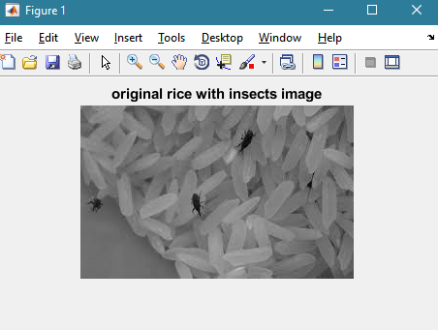
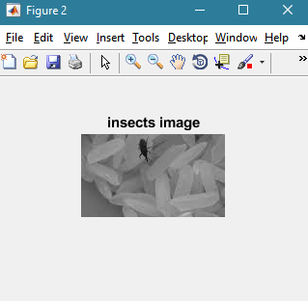
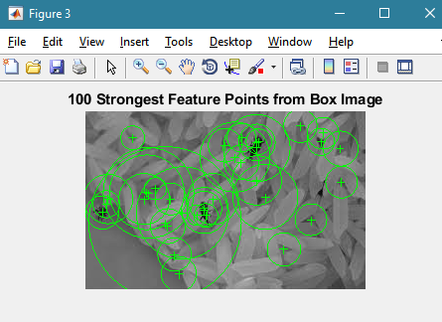
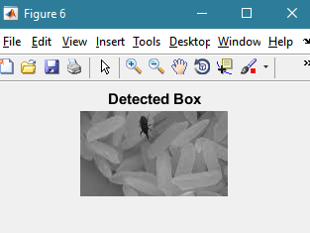
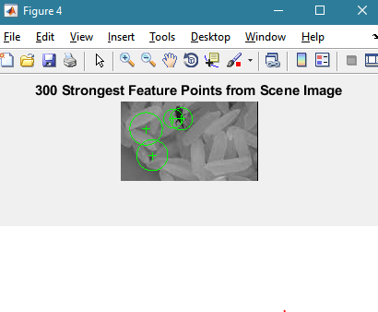
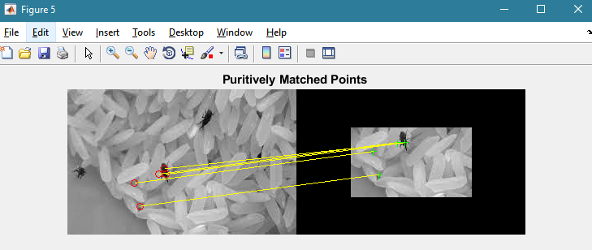

Slide 10
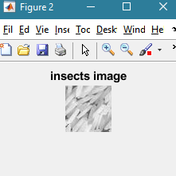
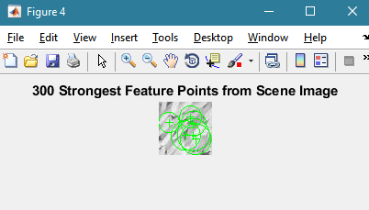

Slide 11
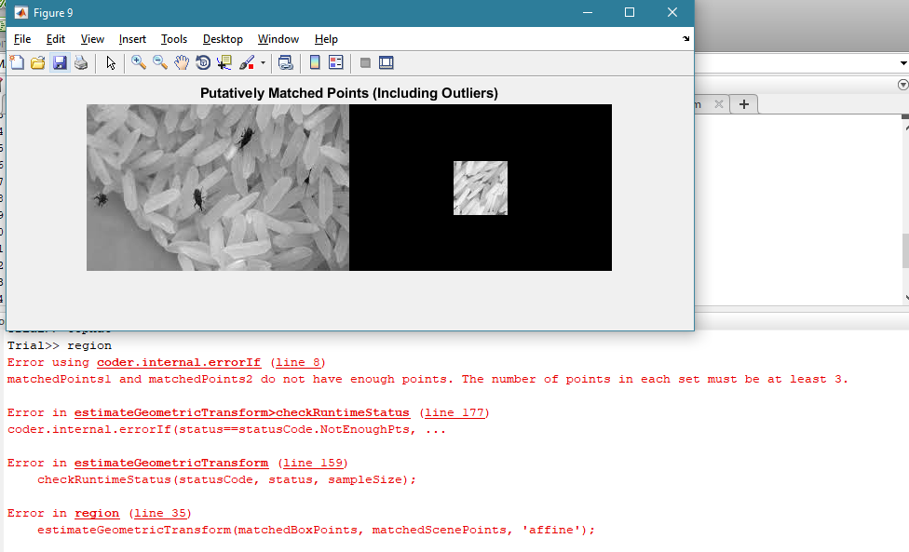

Slide 12
REFERENCES:
Paper by Wan Putri N. W. M. Tahir, Norhaida Hussin, Zaw Zaw Htike and Wai Yan Nyein Naing Department of Mechatronics Engineering, Faculty of Engineering, International Islamic University Malaysia, Malaysia
[1] D. M. Hobson, R. M. Carter, Y. Yan. 2007. “Characterisation and Identification of Rice Grains through Digital Image Analysis” University of Kent.
[2] Bin Lv, Bin Li, Sha Chen, Jian Chen, Bo Zhu. 2009. “Comparison of color techniques to measure the color of parboiled rice” Huazhong Agricultural University.
[3] Fumiaki Takeda, Hisaya Uchida, Take0 Tsuzuki, Hiroshi Kadota and Satoshi Shimanowhi. 2002. “A Proposal of Grading System for fallen rice using Neural Network”, Kochi University of Technology.

